Slide 1


Slide 2
UNCOVER THE ROLE OF GREENHOUSE GASES IN YOUR NEIGHBOURHOOD
Human-caused (anthropogenic) greenhouse gas emissions and natural systems that produce and absorb greenhouse gases (sources and sinks) interplay in a complicated manner to contribute to global climate change. As policymakers and citizens race to combat climate change, understanding this interplay is more important than ever. Your challenge is to use a combination of satellite and model-based datasets to map both human-caused and natural greenhouse gas emissions to enable better understanding of how these emissions contribute to a warmer world.
About challenge

Slide 3
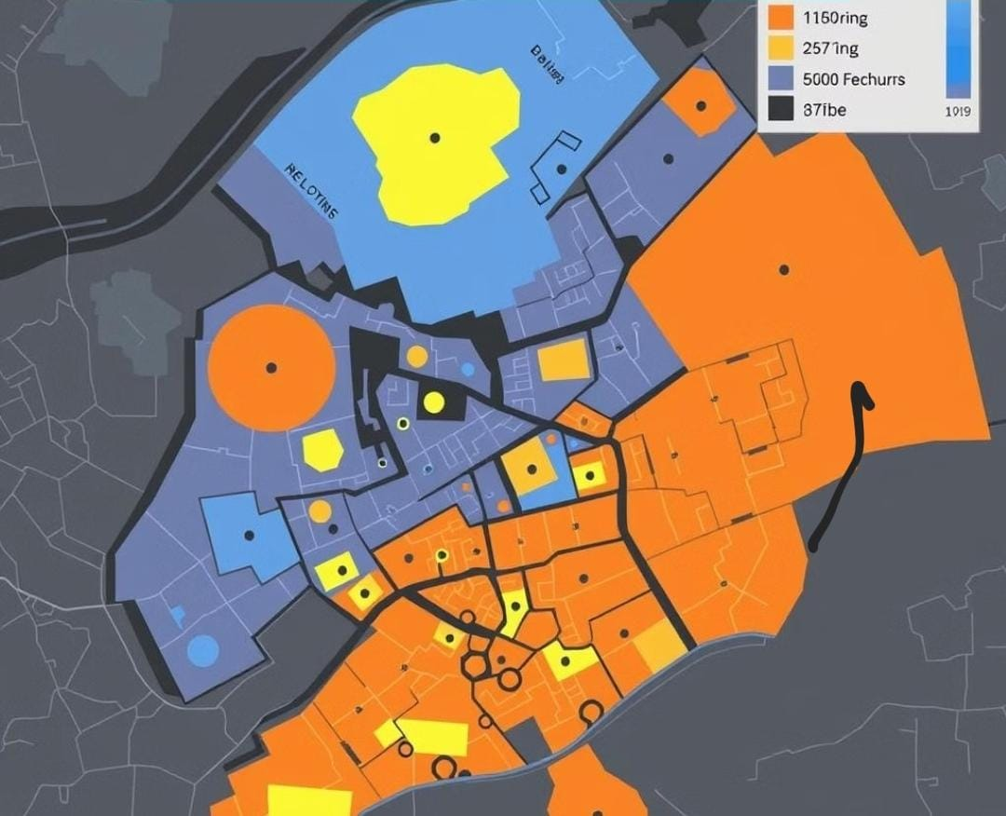
Measure your neighborhood’s carbon footprint
Source | Greenhouse Gas | Emission Amount
Transportation | Carbon Dioxide | 100 tons
Electricity Generation | Carbon Dioxide | 50 tons
Industry | Carbon Dioxide | 25 tons

Slide 4

Understand The Source Of Greenhouse Gases
Greenhouse gases (GHGs) are atmospheric gases that trap heat, contributing to the greenhouse effect, which leads to global warming and climate change. Here's a breakdown of the main sources of these gases:
Carbon Dioxide (CO₂)
.Source : Primarily from burning fossil fuels like coal, oil, and natural gas in power plants, vehicles, and industries. Deforestation and land-use changes also release CO₂ as trees store carbon.
.Contribution : The largest contributor to human-caused climate change due to its sheer volume.
2. Methane (CH₄)
.Source : Agriculture (especially from livestock like cows), landfills, and natural gas production and distribution . Wetlands also naturally emit methane.
.Contribution : Methane is much more potent than CO₂ in trapping heat, though it exists in smaller quantities and breaks down more quickly in the atmosphere.

Slide 5
3. Nitrous Oxide (N₂O)
. Source : Agricultural activities, particularly the use of nitrogen-based fertilizers, and industrial processes. Combustion of fossil fuels and biomass also releases N₂O.
. Contribution: Nitrous oxide is over 300 times more effective at trapping heat than CO₂.
4. Fluorinated Gases
. Source : Industrial processes, refrigerants, and solvents. These include gases like hydrofluorocarbons (HFCs), perfluorocarbons (PFCs), and sulfur hexafluoride (SF₆).
. Contribution : Though present in small quantities, these gases have a very high global warming potential (GWP), making them significant contributors per unit emitted.
5. Water Vapor (H₂O)
.Source : Evaporation from oceans, lakes, and rivers. While not directly influenced by human activities, the warming caused by other GHGs increases evaporation rates, amplifying the greenhouse effect
.Contribution : Water vapor is the most abundant GHG but is largely controlled by natural processes and acts as a feedback rather than a direct human-caused driver.

Slide 6

This is Pingo, the penguin. His home in the Atlantic is melting because of something invisible but powerful – greenhouse gases. Pingo is losing his home, and he needs help to understand what is happening.

Slide 7

Pingo is desperate to understand why this is happening and what can be done. He needs a friend who can help him uncover the cause of these changes.

Slide 8
Transition to webpage

Slide 9

Pingo says thank you! And he’s counting on us to keep taking action to ensure that his home—and our world—remains safe."

Slide 10
Question time

